Slide 1
REPERFUSIVE STRATEGIES IN ACUTE ISCHAEMIC STROKE: OUR EXPERIENCE AND FUTURE WORKING HYPOTHESIS
F. Amati¹, C. Chiapparino², G. Liaci¹, L. Pascazio¹
¹Stroke Unit, Department of Neuroscience, Policlinico Hospital, Bari, Italy
²Department of Neurology, “F. Perinei” Hospital, Altamura (BA), Italy

Slide 2
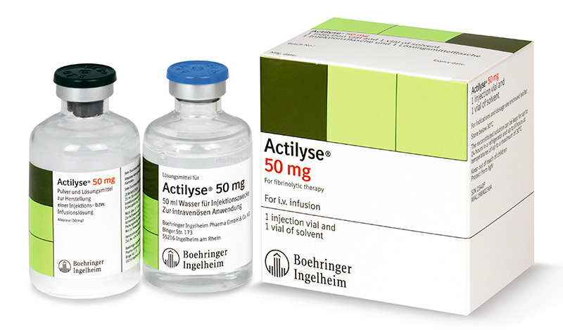
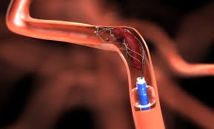
Background and aim
Intravenous thrombolysis and mechanical thrombectomy are the approved treatments for acute ischaemic stroke, but they are not always successful.
The aim of this study is understanding the ischaemia pathophysiology in order to suppose adjuvant therapeutic strategies.

Slide 3
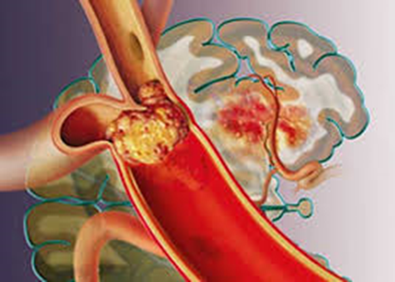
Methods
223 AIS patients (pts.), referred to the Emergency Department, underwent intravenous thrombolysis (IV-TL) and/or endovascular treatment (EVT).
Work-up: brain CT-PW/CTA, brain DW-PW-FLAIR MRI in selected cases, diagnostic and therapeutic digital angiography (DA), ultrasound monitoring.

Slide 4
Results
147/223 (65.9%) pts. received IV-TL;
76/223 (34.1%) pts. underwent EVT, isolated (32/76 – 42.1%) or associated with IV-TL (44/76 – 57.9%).
DA confirmed the steno-occlusions detected by CT-AG showing active collaterals in 55 pts. (72.3%); 30 pts. (39%) exhibited complete (TICI 3) and early recanalization.
TCCD highlighted in 40 pts. (55%) total and early recanalization (TIBI 5); the other pts. showed total and slow, partial, minimal or absent recanalization.

Slide 5
Outcomes at three months:
favourable (mRS: 0-2) in 137/223 (61.4%) pts.;
moderate disability (mRS: 3) in 21/223 (9.4%) pts.;
unfavourable (mRS: 4-6) in 65/223 (29.2%) pts.
The latter pts. being often affected by TACS, having a greater atheromasic load, poor collateralization and more haemorrhagic complications.
Concerning subjects receiving EVT, the best outcome was obtained with the associated treatment (30/44 pts. – 68.2%) compared to isolated treatment (9/32 pts. – 28.1%).

Slide 6
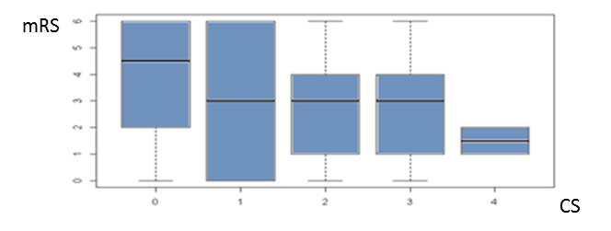
Statistics
Tendency to favourable outcome in pts. with primary compensations and higher Collateral Score, highlighted by both DA and TCCD;
a higher TICI correlates with a better outcome at three months (p<0.005);

Slide 7
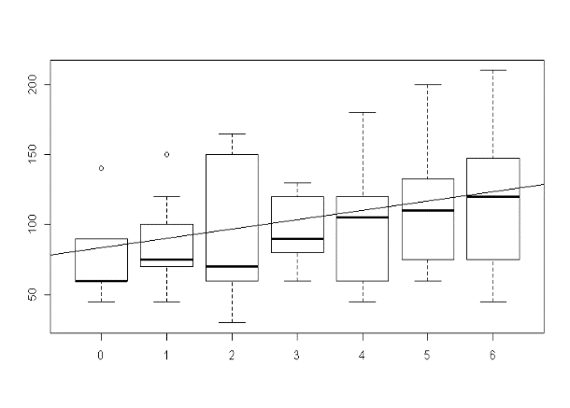
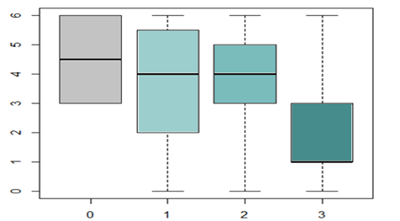
correlation between shorter procedure and lesser disability at three months (p<0.001);
correlation between lysis or compensation-induced recanalization, confirmed ultimately by TCCD, and favourable outcome (p<0.005).
Procedure Time M’
L e C
mRS

Slide 8
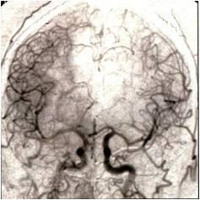
Discussion
Reperfusion is achieved through thrombolysis and/or collateral flow with a better outcome when both events occur.
Ineffective congenital collateralization or macro- and microcirculation damage may impair any compensation modality, brain self-regulation included, with slower flow, thrombosis and haemorrhagic complications. Thus, far from inducing reperfusion, recanalization procedures can result in re-occlusion.

Slide 9
Conclusions
This study shows that, while providing satisfactory results, the above strategies are not always successful (favorauble outcome in 61.4%) pts.
The best outcomes were obtained:
by thrombolysis and/or collateral flow and better with both events
in subjects undergone bridging therapy
Therefore, additional and alternative therapies should be considered, encouraging studies and trials that support thrombolysis and strengthen the rete mirabile.

Slide 10
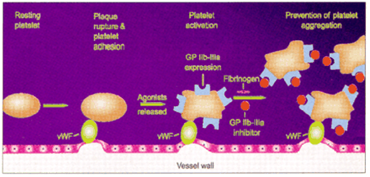
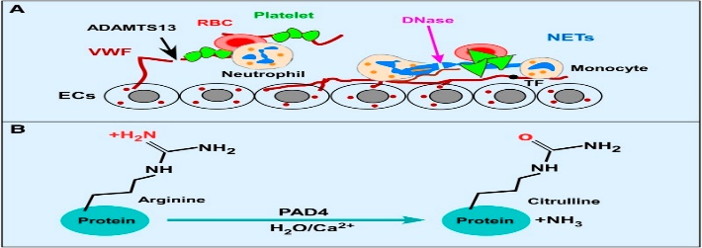
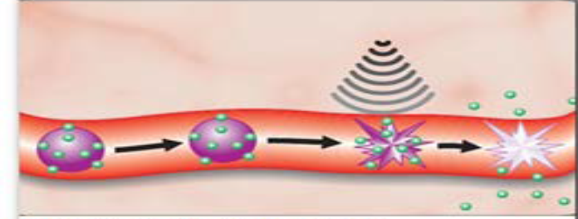
Alternative therapeutic strategies:
Different thrombolytics (tenecteplase, desmoteplase, etc.);
Thrombolytic combined with antiplatelet agents or anticoagulants at different doses: rt-PA associated with antiplatelet agents and anticoagulants (aspirin, eptifibatide and argatroban, heparins);
Antibodies neutralizing pro-thrombotic factors: anti-TAFI (thrombin activatable fibrinolysis inhibitor);
Nanobodies
Caplacizumab Nb against vWF
against DAMP ( damage associated molecular patterns ) etc.
ADAMTS-13 enzymes against vWF and Nets
Targeted sonothrombolysis by microbubbles linked to abciximab (GP IIb/IIIa inhibitor), rt-PA linked to ecogenic liposomes, magnetic targeted mbs ( in vitro ).
(Novel Ultrasounds, albeit with the support of other large clinical trials )

Slide 11
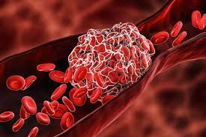
The Goal is therefore characterized by the identification
of a successful thrombolytic cocktail that, adjuvated by
US, can lead to reperfusion.

